Slide 1
Page Ranking
Nathaniel Everett
CS432

Slide 2
What exactly is page ranking?
First off, consider what a search query is. When you make a search query, the engine tries to return results of the highest quality.
PageRank was actually invented by Google’s founders, Larry Page and Sergey Brin.
PR evaluates both the quality and quantity of links to a webpage, determining relativity and score on a scale of 0 to 10.

Slide 3
TF rankings and IDF rankings
TF - term frequency, how often a term appears in a document.
IDF - inverse document frequency, how important a term is, weigh down frequency of terms while scaling up rare ones.
TF calculation: TF(t) = (# of times a term t is in a document)/(total number of terms in a document)
IDF calculation: IDF(t) = log_{e}(total number of documents)/(number of documents with term t in it)

Slide 4
Example problem
A document has 500 words with the word faucet appearing 12 times. The term frequency for faucet is TF(faucet) = 12/500 = 0.024
Say that there are 1000 documents and faucet appears in 150 of these. The inverse document frequency is IDF(faucet) = log(1000/150) ≈ 0.824

Slide 5
TF-IDF
This term is simply the multiplication of both the TF and the IDF!
From the previous example: TF(faucet) * IDF(faucet) = 0.024 * 0.824 = 0.00198
Intended to reflect how important a word is to a document, collection, or corpus, used for text mining, information retrieval, and user modeling. It can also be used for stop-word filtering for fields such as text summarization and classification.

Slide 6
Other page ranking methods
Google PageRank
Alexa

Slide 7
Google PageRank
Named after Google founder Larry Page.
Works by counting the number and quality of links to a page to determine the estimate of how important a website is.
Algorithm: PR(A) = (1-d) + d(PR(T₁)/C(T₁) + … + PR(T_{n})/C(T_{n}))
PR(A) = PageRank of page A, PR(T_{i}) = PageRank of pages T_{i} that link to page A
C(T_{i}) = number of outbound links on page T_{i}, d = damping factor between 0 and 1

Slide 8
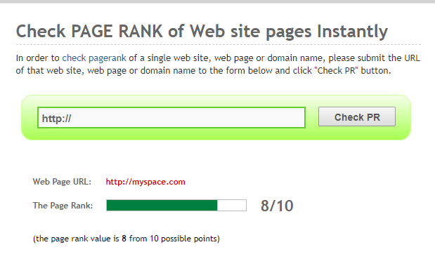
Google PageRank example
The more outbound links a page T has, the less page A will benefit from a link to it from page T
Weighted PageRanks are added up, then multiplied by the damping factor.

Slide 9
Alexa
A more advanced page ranking tools, getting website traffic, statistics, and analysis.
Owned by Amazon
Measures popularity, visitor metrics, audience geography, upstream sites, linking sites, related sites, how fast a site loads, audience demographics

Slide 10
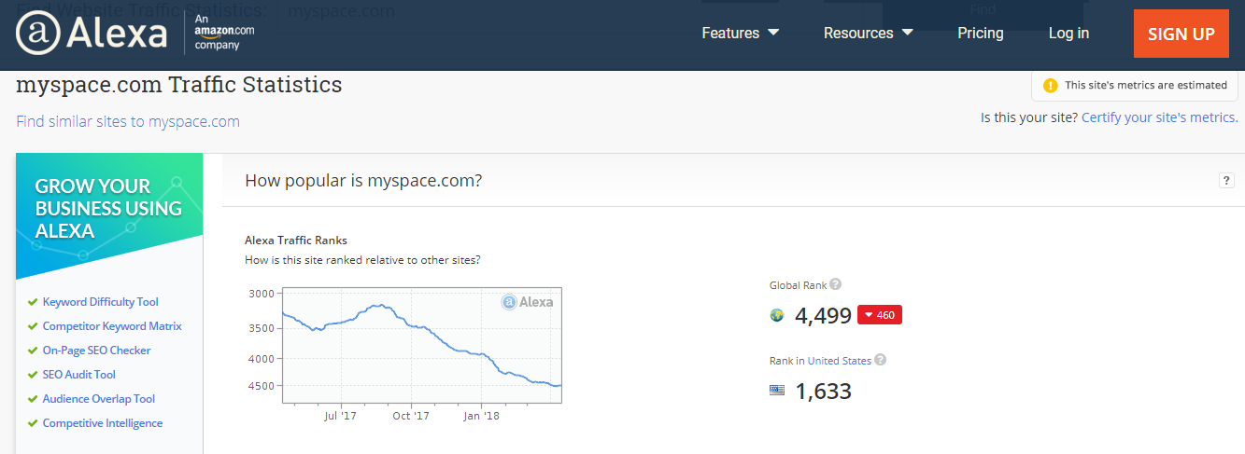
Alexa example

Slide 11
Conclusion
In summary, page ranking is a major ranking for Google and other engines to determine the relevancy and the popularity of websites.
With different tools using different algorithms, there are a number of ways to calculate a page’s rank.
Term Frequency and Inverse Document Frequency are important to know for determining page rank.

Slide 12
References
Adams, Chelsea. “What Is Google PageRank, How Is It Earned & Does It Matter in 2016?”Bruce Clay, Inc. Blog, 9 June 2016, www.bruceclay.com/blog/what-is-pagerank/.
Tf-Idf :: A Single-Page Tutorial - Information Retrieval and Text Mining.” Tf-Idf :: A Single-Page Tutorial - Information Retrieval and Text Mining, www.tfidf.com/.
Sobek, Markus. “The PageRank Algorithm.” Google PageRank - Algorithm, EFactory GmbH & Co. KG Internet-Agentur, 2002, pr.efactory.de/e-pagerank-algorithm.shtml.

